Slide 1
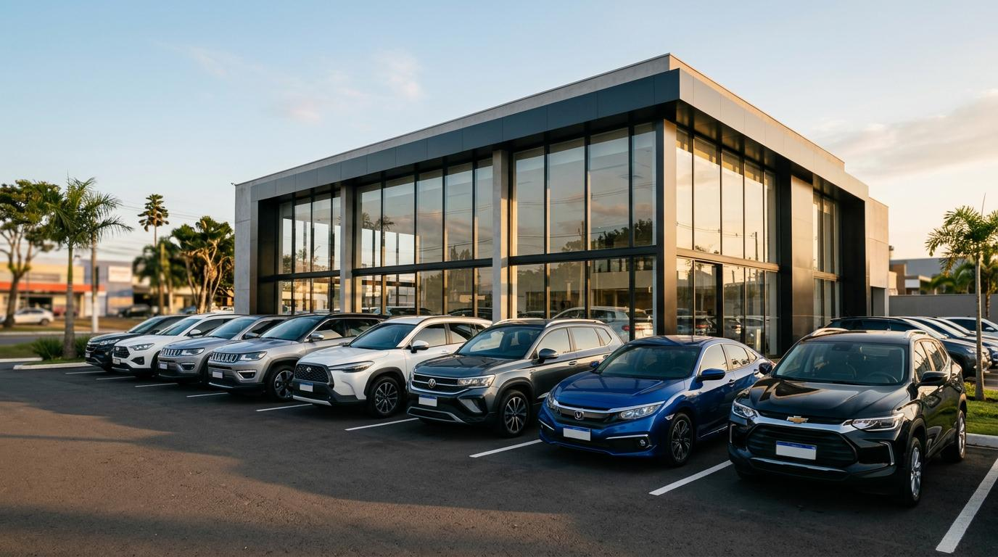
CMSE 830 • MIDTERM PROJECT
Project: Used-Car Price
What factors are associated with used-car prices?
An interactive data exploration app for people shopping for a used car
Presenter: Masoud Moradi Date: 10/15/2026

Slide 2
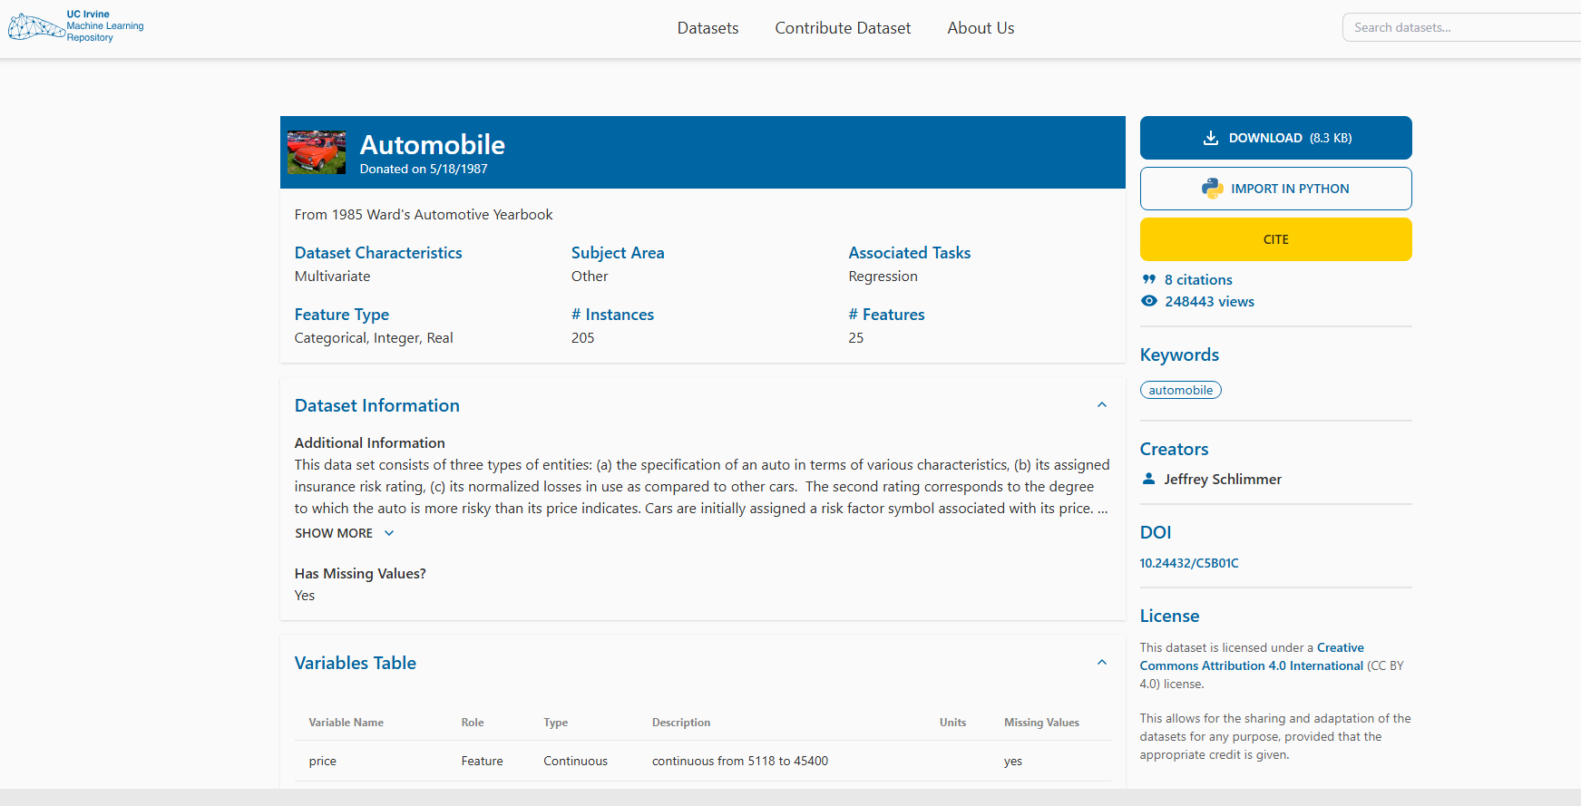
01 • PROBLEM, AUDIENCE & DATA
Helping buyers explore price differences
1. The audience
2. Questions
3. Candidate dataset
People who are considering buying a used car and want to compare vehicle characteristics.
• Does horsepower relate to price?
• Do larger engines tend to cost more?
• How do prices differ by manufacturer?
UCI Automobile dataset
- 205 observations
- 25 variables
One row represents one automobile
Source: UCI Machine Learning Repository — https://uci-ics-mlr-prod.aws.uci.edu/dataset/10/automobile
CMSE 830 • Midterm Project
2

Slide 3
02 • DATA PREPARATION
Make the data ready to explore (Initial Data Analysis)
1. Numerical variables
2. Categorical variables
3 .Quality checks
Price
Horsepower
Engine size
Curb weight, MPG, length and width
Use numeric summaries and distributions.
Manufacturer (make)
Body style
Fuel type
Drive wheels
Check category spelling and group sizes; encode if a model requires it.
Inspect data types and dimensions
Count missing values in price and horsepower
Check unusual values and duplicates
Confirm how dropped rows affect results
CMSE 830 • Midterm Project
3

Slide 4
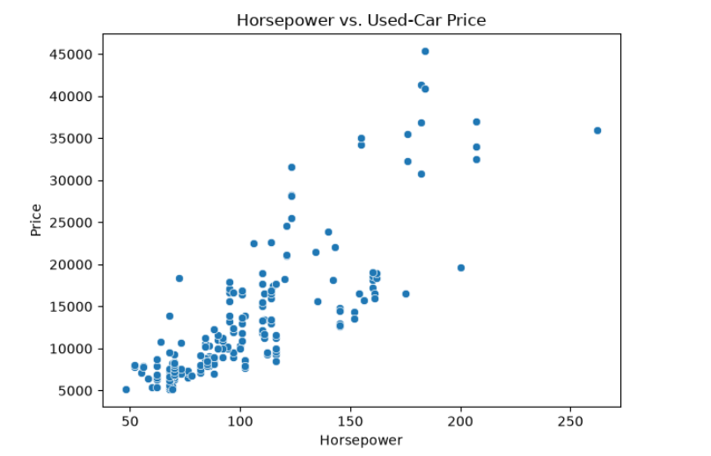
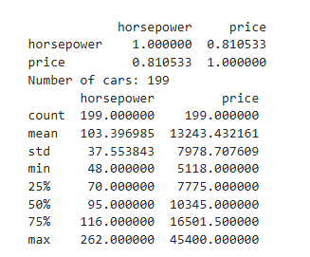
03 • EDA VISUALIZATION
Question 1: Is horsepower related to price?
I used a scatter plot because both variables are quantitative.
What to look for:
The scatter plot shows that cars with higher horsepower tend to have higher prices.
The correlation is strong and positive (0.81).
However, other factors also affect price, and the dataset is small.
CMSE 830 • Midterm Project
4

Slide 5
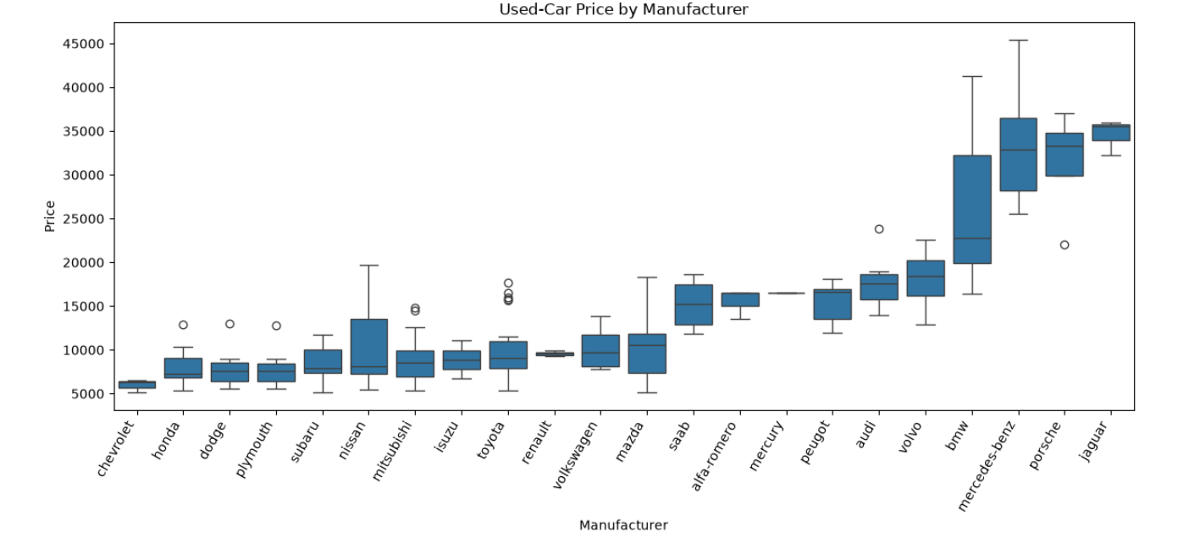
03 • EDA VISUALIZATION
Question 2: How do prices differ by manufacturer?
I used a box plot to compare the distribution of a numeric variable across categories.
How to interpret:
The box plot shows that median prices vary by manufacturer, suggesting an association with price.
The summary table shows each manufacturer’s median price and sample size.
Other car features also affect price, and manufacturers with few cars may have less reliable comparisons.
CMSE 830 • Midterm Project
5

Slide 6
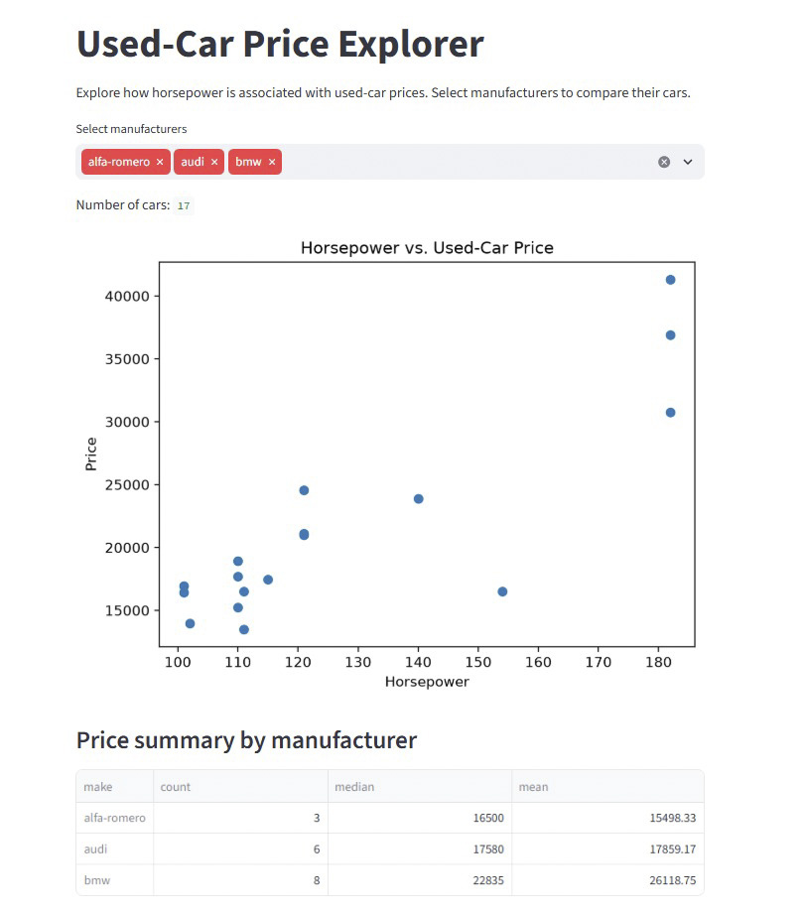
04 • INTERACTIVE DATA PRODUCT
A user can explore selected manufacturers
Interaction
The user chooses one or more manufacturers with a multiselect control.
The chart and summary table of the made app will help users to make a better decision.
CMSE 830 • Midterm Project
6

Slide 7
06 • Preliminary Findings & Limitations
What can I responsibly say so far?
Horsepower and price show a positive association.
Median prices vary across manufacturers.
Results should be verified using the plots and summary table.
1. Analysis in Place
2. Preliminary Findings
3. Limitations
Horsepower-versus-price scatter plot.
Manufacturer price summary.
Manufacturer selection control in the app.
The dataset contains 205 cars and may not reflect today’s used-car market.
Missing prices or horsepower and extreme values may affect comparisons.
Small manufacturer groups make comparisons less reliable.
CMSE 830 • Midterm Project
8

Slide 8
Thank you!
Questions & comments?

